Slide 1
HOW TO MAXIMIZE YOUR EXPERIENCE IN THIS WEBINAR
If you are experiencing problems with connectivity (lag, delay, loading signal, echo etc.):
Hover over the video
Click the gear icon on the lower right corner of the video
Click on 360p to lower your resolution
If you’d like to watch this webinar in full screen:
Hover over the video
Click on the icon on the lower right corner of the video
If you’d like to hide the live chat session
Hover over the live chat section
Click the icon on the upper right corner of the live chat section
We’re Monitoring the Chat Function
Notes:
We do these webinars often, and we want you to maximize your experience

Slide 2
KEITH SEEMS IMMUNE TO EVERYTHING

Slide 3
RENT COLLECTION DURING COVID 19: SURVEY DATA & FOLLOW UP STRATEGIES
30+ Years in the Rental Apartment Business across North America
Worked through 17 global and local recessions
Apartment Leasing, Apartment Brokerage, Student Housing, New Apartment Construction
Derek Lobo, CEO Broker of Record
Thanks to all survey participants
Notes:
BIG YELLOW TAXI – We got a call from CRTC saying we weren’t playing enough Canadian content, so that was Jonie Mitchell, born in Alberta, Big Yellow Taxi
I take some solace in what Benjamin Tal said yesterday: ‘this is a crisis that has an end game. And it’s a vaccine and this thing is over.’
The rent problem is a rounding error in the greater economy, not for you today, but in the grand scheme of the economy.

Slide 4
WHAT’S OUR GOAL?
We want to eliminate your dangers
Capture the opportunities
Reinforce your strengths

Slide 5
APARTMENT DEVELOPERS UNIVERSITY 2020
24 Standalone Modules over 12 weeks
Begins Tuesday April 21ST, 3PM EST
Registration will be on our webpage shortly
www.svnrock.ca
Notes:
This is our last webinar on COVID and rent collection.
We don’t think there’s much more to say, other than what we have to say here today. And unless there’s a major change, we’re moving on to the next opportunity.

Slide 6
WHAT DID DOUG FORD REALLY SAY?
"If you have a choice between putting food on your table or paying rent, you’re putting food on your table. The government of Ontario will make sure that no one gets evicted.”
"I heard there was a petition going around [saying] 'Just don’t pay rent.' That’s wrong. That’s hurting people across the board. We’re standing up for the tenants here so please don’t take advantage of it”
"And if you can’t pay rent, and you’re just in absolutely crisis, then you don’t have to pay rent."
Notes:
I got a call from a reporter last night from the Toronto Star.
What we’re doing is taking a conversation that Doug had with a reporter, and trying to interpret that into legislation.
It’s more complicated than tenants just not paying rent. The province has suspended eviction hearings at the Landlord Tenant Board for the duration of this pandemic. It doesn’t mean that tenants don’t have to pay their rent. It’s a deferral of rent.
And to imply anything else would be irresponsible and negligent.
Enough said about this, but I did confirm with the Toronto Star reporter that she had paid her rent.

Slide 7
AGENDA
Key Findings from our Cross-Canada Survey
The View from Larger Owners
Survey Results – Small Building Survey
Synthesis of Comments
Advice for May Rent

Slide 8
RENT COLLECTION DURING COVID 19: OUR RESEARCH
Who Paid Rent April 1st?
Small Building Survey: Cross Canada
Calls to Large Landlords across Canada
284 Responses
~ 2,400 Units
10+ Calls
5,000 - 50,000 Units across Canada
Notes:
284 responses, and we got detailed responses about 2,400 rental units.

Slide 9
WHO PAID RENT APRIL 1ST?
85%
Notes:
If we were to pick a general number…
It didn’t come in on April 1st, and it’s still trickling in.
From our research in the survey and from calling big landlords across Canada, we can conclude that generally across the board, 85% of tenants paid rent April 1st.
There’s a lot of variation in that 85% number, and we’re going to get to that shortly in our survey results.

Slide 10
KEY FINDINGS: RENT COLLECTION DURING COVID 19
Those who could, paid.
C-Class buildings in C-class neighbourhoods suffered the most
A+ buildings with top of market rents, and A & B class buildings in higher income neigbourhoods, mostly seniors with pre-approved payments, saw few defaults
0.5% of residents called in advance, while 15% didn’t pay.
Student Housing: Success depends on management style and what date your lease expires, but there were no real problems for April 1st.

Slide 11
THIS IS HOW IT SHAKED OUT
Upscale seniors building on a preauthorized payment plan
Student Housing
C-Class Buildings
Top of market rent building with students and young renters
Solid B Buildings with Solid B Tenants
New Apartment Construction in Lease Up
RISK
Notes:
Here’s how things shaked out:
C-class buildings suffered a lot more than we thought they would.
And student housing performed better than we expected.
Top of market buildings did better than we thought.
New apartment construction buildings in lease up will remain a challenge, and we have a program to help if you’re in this situation.

Slide 12
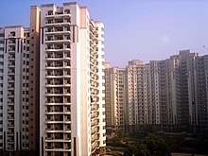
THE VIEW FROM LARGE OWNERS
We spoke with large portfolio owners across the country
Notes:
We spoke to some of the biggest landlords across Canada to complement the survey results that many of you filled in.

Slide 13
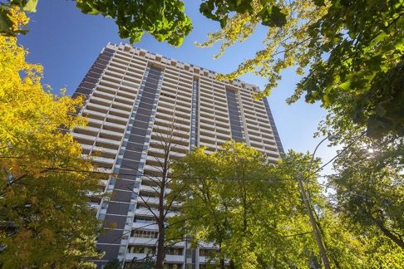
TRANSIT ORIENTED, 1,000 UNITS, OLDER BUILDINGS
Typical Rent Collected: 85%
April 6th Rent Collected: 75%
Change in Collection: -10%
Notes:
When you only get 75% of your rents on April 6th that’s an indicator of the type of building you’ve got.
You would expect this building to maybe have a tougher May.
About 20 people negotiated a deal.

Slide 14
15,000 UNITS: CANADA WIDE
500 requests to defer rent
350 negotiations
85% rent collected overall
Notes:
Less than 1% of tenants contacted management in advance
Lesson Learned: People didn’t want to reach out because human nature is not to want to reach out and skip out on their obligation…
What this means is: You need to reach out to them.

Slide 15
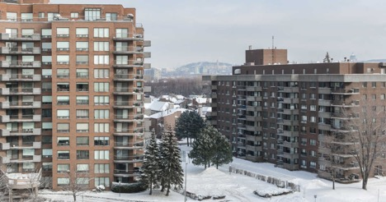
CROSS CANADA PORTFOLIO – 5,000 UNITS
Overall rent Collected: 85%
Toronto & Vancouver: 90%
Alberta & Quebec: 70%
Outlier (low): <50%
Outlier (high): ~99%
Notes:
It’s not one number, it’s individual buildings, and it seems to vary by income more than anything else.

Slide 16
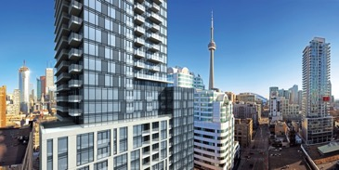
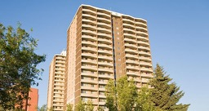
DIVERSIFIED PORTFOLIO ACROSS THE GTA
95% PAID
Avg Rent: $3.50+/sf
87% PAID
Avg Rent:
$ 2.00-3.00+/sf
Non-repositioned 1970s downtown
Repositioned 1970s downtown
Brand new top-of-market luxury
70% PAID
Avg Rent: $ 1.75+/sf
Notes:
(Derek note – it’s Marvin Katz)
This is a good bell-weather diversified portfolio across the GTA of A+, B, and B- product.
It shows the relationship between rental rate and rent collection.

Slide 17
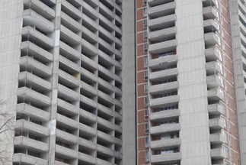
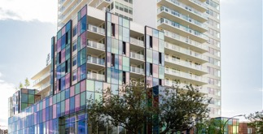
ABOUT B & C NEIGHBOURHOODS
Old buildings: 70%
New buildings: 70%
Notes:
This is a B- neighbourhood with a new building and an old building – showing again that area and income matter. Because most new buildings did well.
Neighbourhood seems to matter, no difference in the rent.

Slide 18
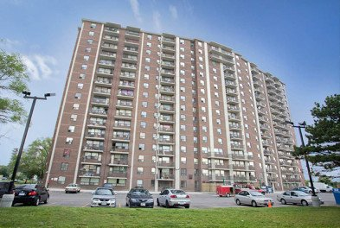
C-BUILDING, C-NEIGHBOURHOOD
Typical Rent Collection: 75% As of March 6th
April Collection: 50% As of April 6th
Change in Collection: -25%

Slide 19
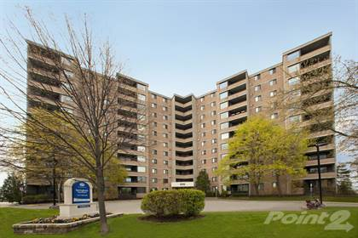
SECONDARY MARKETS, 2,000 UNITS A-QUALITY
April 1st Collected: 98%
Notes:
We’ve had subsequent discussions with a number of other owners who were in good positions like this.
It’s almost as if there was no change – they were impervious to the market.
There were multiple examples of quality buildings really having no issue.
Out of 10,000 units, 60 called, the developer had 70 NSF cheques, same as normal time of year. – BUT 90% of his commercial didn’t pay.

Slide 20
STUDENT HOUSING: 4,000 BEDS
It varied, depending on the landlord’s management style
50% of students are still in the buildings
Notes:
Anyone who was a bad tenant, was a bad tenant before, and after.
International students don’t want to go home because maybe it’s worse there, or maybe they won’t be able to come back to Canada.
Some students are worried they’re not going to be able to get summer jobs, and don’t want to live with their parents all summer.
Generally, pre-leasing is ahead of last year’s number. May to may is a problem. September to September we’ll have to wait and see.
There were only a handful of asks to renegotiate rent.
Institutional student housing owners are in good shape, maybe some private guys who are stretched could feel pain down the road.

Slide 21
SMALL BUILDING, CROSS-CANADA SURVEY
284 Responses
~2,400 units of detailed information
Full report ready for download next Tuesday – April 14th by survey respondents – link will be sent
High level summary available on www.svnrock.ca for non-survey respondents

Slide 22
WHO RESPONDED?
Owners with less than 5 buildings: 54%
Owners with more than 6 buildings: 46%
Notes:
Half of the respondents were owners with 5 or less buildings, and the other half had more than 5 buildings.

Slide 23
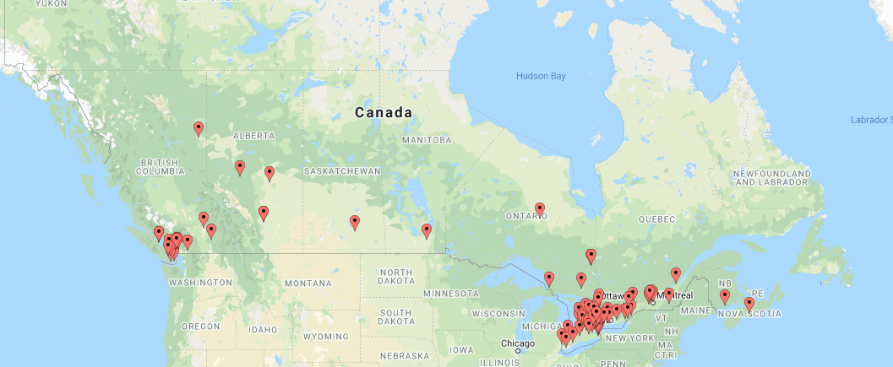
WHO RESPONDED?
Notes:
We got responses from across the country – in primary, secondary and tertiary markets.

Slide 24
WHO PAID APRIL 1ST? BY GEOGRAPHY
Key Trends:
Buildings across Quebec struggled more, regardless of age, than in any other location
Outside of Quebec, major markets – Toronto, Montreal, Halifax, had highest rates of deferrals regardless of age of building
Secondary and tertiary markets seemed most stable

Slide 25
PRE-1960S BUILDINGS (OLDEST BUILDINGS): 78% PAID
Notes:
More saturated markets of Toronto, suburban GTA, London and Montreal seemed to have the most difficulty in collecting rents in older buildings.

Slide 26
1960S-1989 BUILDINGS (MIDDLE AGED BUILDINGS): 79% PAID
Notes:
Where was there challenges? Throughout Quebec and in Toronto core.

Slide 27
1990-2020 (NEWEST BUILDINGS): 87% PAID
Notes:
There was less variation in new buildings compared to older buildings in rent collection.
Major markets - Montreal, Halifax, and Toronto had more challenges.

Slide 28
RENTERS WITH LOWEST RENTS WERE MOST AT RISK
% Renters Paid
Notes:
Who’s at risk to not pay their rent? It’s the lowest price one and two bed units.
On the graph, blue and the red are the lowest price units.
The same trend held true for the bachelors.

Slide 29
TENANTS IN SMALLEST UNITS IN OLDER BUILDINGS WERE MOST LIKELY NOT TO PAY APRIL 1ST.
Bachelors in Pre-1960s buildings
1 Beds in 1960-1989 buildings
Notes:
Bachelors in Pre-1960s buildings
1 Beds in 1960-1989 buildings:
Limited income tenants, most likely should have been in a bachelor

Slide 30
PRE-1960S BUILDINGS: BACHELORS MOST LIKELY NOT TO PAY APRIL 1ST
Bachelors in the oldest buildings had the most trouble paying rent. These are the at risk renters.
1 and 2 bed units had modest deferrals.
3 bedroom units performed well: Stable tenants
Notes:
Read the title out
The blue is the amount of rent
The red/orange line is the % collected.
Bachelors in the oldest buildings had the most trouble paying rent. These are the at risk renters.
1 and 2 bed units had modest deferrals.
3 bedroom units performed well: Stable tenants

Slide 31
1960-1989 BUILDINGS: 1 BEDS HAD MOST DEFERRALS
Bachelors performed well.
1 bed units had highest deferrals.
3 bedroom units performed well: Stable tenants
Notes:
Read the title out
Bachelor tenants in 1960s-1990s buildings performed well: These are likely long term tenants on non-employment income.
1 bed units had the highest rate of deferrals: These are entry level tenants who were probably stretching to get into that unit size.
3 bed tenants largely paid their rent: Again, these are probably longer term tenants.

Slide 32
NEW BUILDINGS: 1 AND 2 BED UNITS HAD MOST DEFERRALS
1 and 2 bed units had highest deferrals.
3 bedroom units performed well: Stable tenants
Notes:
Read the title out
1 and 2 bed tenants had the highest rates of deferrals: They’re probably tenants who were reaching financially to get in the building.
3 bedroom tenants in new buildings had a much lower rate of deferrals. These are strong rents, and the tenants are probably more stable than tenants in the other unit sizes.

Slide 33
SURVEY RESPONDENT COMMENTS
The number of tenants that did not pay is not as bad as we anticipated.
Work with the tenant, no hard ball. You need to see tenants as people more than ever.
Communicating with our tenants in advance was key.
I think the notices that we provided tenants about the program helped
I am dealing with 6 retail spaces…none paid so far.

Slide 34
SURVEY RESPONDENT COMMENTS
Our best applicants did the best:
The people we have selected have been the best applicants when deciding who we were giving our units to…They all either paid early, paid in full, a few more paid 1/2 months rent for now and waiting on EI cheques.
Majority of tenants appreciated us reaching out in advance of April 1st.
Generally, there was concern about May 1st.
Notes:
Our best applicants did the best: You have to choose your tenants wisely. A bad tenant before was a bad tenant April 1st. A good tenant before was still a good tenant.
About May 1st: If we have something worthwhile to say we’ll report back, but not unless it’s worthwhile.

Slide 35
PREPARING FOR MAY 1ST
Most think it’s going to be worse than April 1st
But April wasn’t as bad as we thought…
Bonus your front line staff
The forms are still on our webpage
Don’t get dragged into public debates.
Deal with tenants individually.
Reply fast.
Offer positive alternatives to make tenants’ life easier.
Notes:
Watch our previous webinars.
April wasn’t as bad as we thought so let’s not get carried away.
There might be more government announcements, so let’s wait for that.
Tenants are going to misbehave because they’re bored. For example they’re going to smoke in the building now.
I take some solace in what Benjamin Tal said yesterday: ‘this is a crisis that has an end game. And it’s a vaccine and this thing is over.’

Slide 36
WATCH OUT FOR OUR COMPREHENSIVE REPORT: TUESDAY APRIL 14TH
It’ll be released this coming Tuesday, April 14th, via email to all survey respondents.
We’ll be posting our high level conclusions on our website: www.svnrock.ca

Slide 37
APARTMENT DEVELOPERS UNIVERSITY 2020
24 Standalone Modules over 12 weeks
Begins Tuesday April 21ST, 3PM EST
Visit our website for registration
Notes:
This is our fifth webinar on COVID and rent collection.
We don’t think there’s much more to say, other than what we have to say here today. And unless there’s a major change, we’re moving on to the next opportunity.
Our job is to eliminate your dangers, capture your opportunities, and reinforce your strengths.
COVID is clearly a danger. Now we want to next alert you to the best opportunity in Canada. And then, we’d like to help you focus your strengths on this opportunity.
While COVID is still here, we look forward to this being in the rearview mirror.
I’m looking ahead to what comes after this interesting period.

Slide 38
THE PROGRAM
This is a free 12-week course, with 24 stand alone modules.
We’re covering everything from finding a piece of dirt, taking it through feasibility and financing, construction, through to lease-up, stabilization and the sale of the building.

Slide 39
APARTMENT DEVELOPERS UNIVERSITY 2020
Why Apartments?
Building apartments is about wealth creation.
Building homes is about making profit and paying tax.
Notes:
Building apartments is about wealth creation. The apartment developers of the 1960s and 70s built successful portfolios that have been handed down to their children, and their children’s children. Building apartments is about wealth preservation, tax deferral and cash flow.
Home builders from the 1960s and 70s – many are gone and a lot of the profit they paid went to taxes, and there were no generational assets to hand to their children. Building homes is about making profit and paying tax.

Slide 40
IT’S THE PERFECT STORM FOR APARTMENT DEVELOPMENT
Apartment Development Fundamentals are extraordinarily strong and will remain so in a post-COVID environment:
From a Renter standpoint
From an Investor standpoint
From a Financing perspective
Land and Construction Costs:
Notes:
From a renter standpoint, there is an acute shortage of high quality rental product across the country – that’s not going to change.
From an investor standpoint (pension funds have money to deploy), most institutions are under-weighted in apartments. And they only want Class A product – apartment buildings that look like they’re office buildings. If you build it, renters will come, and investors will buy it.
From a financing perspective: Construction and takeout financing is available right now at extraordinarily low interest rates for the foreseeable future.
Land and Construction Costs: It’s also reasonable to assume that land costs and construction costs may come off in the near term

Slide 41
24 STAND-ALONE ONLINE MODULES OVER 12 WEEKS
# | Module Title & Description | Date
1 | Course Overview; & What Makes a Good Rental Site? We're going to cover the fundamentals of land acquisition | Tuesday April 21st, 3pm EST
2 | The BIG Question: Build to Keep or Build to Hold - How Do You Make a Decision? Depending on if you build to keep or sell, you're going to build a different building. | Friday April 24th, 3pm EST
3 | What Should I Build? : What's My Unit Mix? What's my Unit Size? | Tuesday April 28th, 3pm EST
4 | Amenities That Drive Rents: What are the 'must have' amenities, and what amenities do you put in for my target renters? | Friday May 1st, 3pm EST
5 | How Much Parking Do I Really Need?: Parking is one of the most expensive components you build with the lowest return. Getting the right amount of parking is a crucial decision. | Tuesday May 5th, 3pm EST
6 | Financing New Apartment Construction: How to Make Your Development Attractive to Lenders; When, and When NOT to Use Mezzanine Financing; CMHC Financing | Friday May 8th, 3pm EST

Slide 42
24 STAND-ALONE ONLINE MODULES OVER 12 WEEKS
# | Module Title & Description | Date
7 | How to submeter a newly constructed apartment building | Tuesday May 12th, 3pm EST
8 | What's the Depth of the Market? How Many Units can you absorb in a year? | Friday May 15th, 3pm EST
9 | The 4 Factors that Drive Rent: And Why You Have to get All 4 Correct | Tuesday May 19th, 3pm EST
10 | Municipal Taxes and The Pros and Cons of Condo Titling Your Purpose Built Rental Project | Friday May 22nd, 3pm EST
11 | A Fieldguide to Rental Apartment Development By The Numbers: Building a Detailed Financing Feasibility Model & Stress Testing It | Tuesday May 26th, 3pm EST
12 | How to Structure a Joint Venture so the Developer Wins | Friday May 29th, 3pm EST

Slide 43
24 STAND-ALONE ONLINE MODULES OVER 12 WEEKS
# | Module Title & Description | Date
13 | Advanced Lease Up Strategies: Hiring, Training, Managing, and Compensating Leasing Staff for Maximum Results | Tuesday June 2nd, 3pm EST
14 | Creative Strategies to Build Affordable Housing | Friday June 5th, 3pm EST
15 | What Built Forms Work Best & Where? 4-6 Storey Wood, Cold Rolled Steel, Pre-Cast and Concrete | Tuesday June 9th, 3pm EST
16 | Advanced Lease Up Strategies Revisited | Friday June 12th, 3pm EST
17 | Advanced Rent Setting and Revenue Management Strategies During New Construction Lease Up | Tuesday June 16th, 3pm EST
18 | Property Management: It's All About the Customer Service Do I Lease My Building Myself? Or do I hire a 3rd Party Manager | Friday June 19th, 3pm EST

Slide 44
24 STAND-ALONE ONLINE MODULES OVER 12 WEEKS
# | Module Title & Description | Date
19 | Accessorizing the Apartment Building Do I Need Model Suites? How do I finish the lobby? What's the 'bling'? | Tuesday June 23rd, 3pm EST
20 | Writing the Marketing Plan to Get Your Building Full at the Highest Rent | Friday June 26th, 3pm EST
21 | Getting the Brokerage Deal Done: How to Design, Build, Lease, and Manage an Apartment Building that will be sold! | Tuesday June 30th, 3pm EST
22 | How Does a Smaller Developer Compete? $5 rents in downtown Toronto or $2 in small town Canada? | Friday July 3rd, 3pm EST
23 | Student Housing: Purpose built student housing vs. conventional apartments designed for students | Tuesday July 7th, 3pm EST
24 | Graduation Day: Developing Your Plan to Become a Merchant Apartment Builder | Friday July 10th, 3pm EST

Slide 45
2 FOR 1 COCKTAILS AFTER EVERY FRIDAY MODULE
Join us for cocktails after each Friday module.
We’ll be answering questions directly in the chat room in live time

Slide 46
STAY HEALTHY AND STAY SAFE!
Thank you for joining us for the last 4 weeks
This was the last of our COVID webinars, we’ll continue to monitor the situation and offer advice
Re-watch any webinar through our website: www.svnrock.ca
Join us in our next chapter during lockdown: Apartment Developers University starting Tuesday April 21st, 3pm EST Open House Friday April 17th, 3pm EST with Cocktail Hour

