Slide 1
Are Purpose Built Rental Apartments Recession Resistant?
30+ Years in the Rental Apartment Business across North America
Worked through 17 global and local recessions
Apartment Leasing, Apartment Brokerage, Student Housing, New Apartment Construction
WEBINAR WILL BEGIN SHORTLY
Derek Lobo, CEO Broker of Record

Slide 2
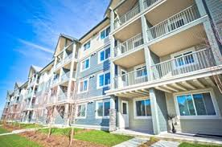
OTHER THAN DRUG STORES, GROCERY STORES & NETFLIX…
ALMOST EVERY INDUSTRY IS ENVIOUS OF APARTMENT OWNERS!
Notes:
Everyone has to live somewhere.

Slide 3
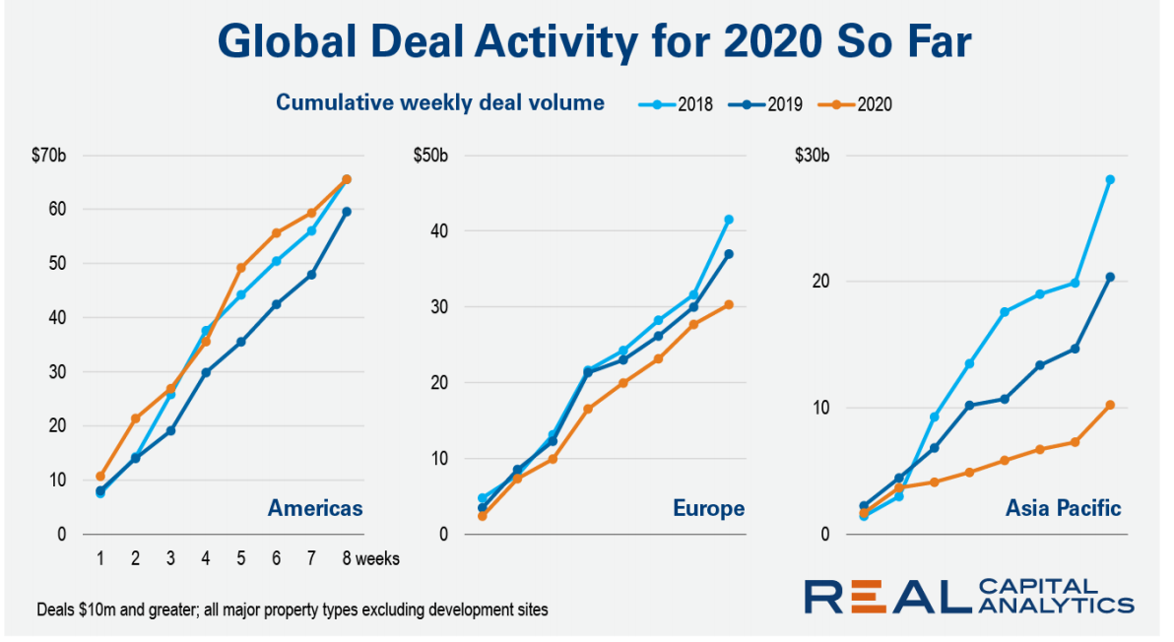
Notes:
Let’s talk about deal flow: You can see clearly for 2020 that there’s been a decline in real estate activity in the Asia Pacific, where COVID has been an issue for the last 8 weeks.
You haven’t seen that in Europe and the Americas because this thing is just upon us and real estate has a lag time. BUT, it would only seem logical that the deal flow is going to get affected with people just not wanting to make a decision.
1 conclusion is fairly obvious: deal flow will drop off, and deals are going to get cancelled, postponed etc.
Lenders are going to take a ‘wait and see’ approach as well.

Slide 4
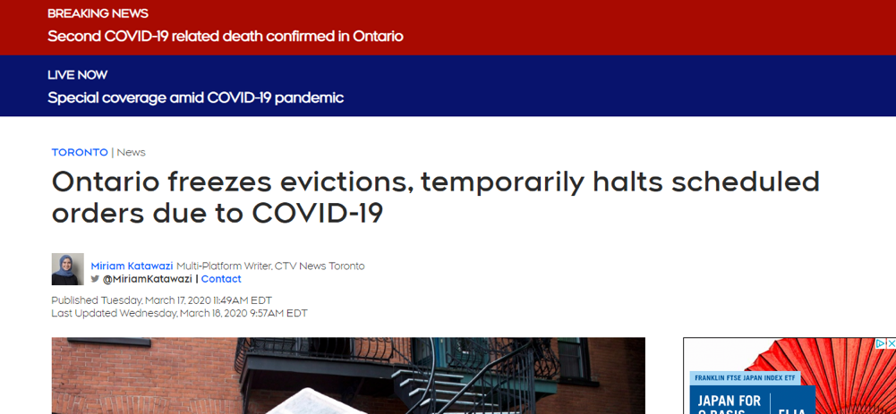
Temporary Government Legislation: Evictions
Notes:
This is the MORAL HAZARD – Tenants are going to get an extension on paying you rent, should your lender give you an extension on paying your mortgage?
Your lenders is going to want to see the quality of your tenant base which they assume is good, but if it’s full of students and roomates you may have a problem, or if it’s full of little old ladies, you’re likely not to have a problem.
Showing a good resident profile might be helpful in calming your lender. This has to be done at the site level, and it’s tricky work.

Slide 5
SHOWCASE IDEA: WHAT TO DO
Consider paying your building staff a one time surprise bonus – there is more work to do, and more risk.
Notes:
All of you are in your spare bedroom working away, eating good food (you probably haven’t started cooking the beans and rice you’ve got stored in the basement), probably drinking too much in the evening. Meanwhile, your staff is on the front line with people coughing on them, dealing with kids who are home from school….

Slide 6
SHOWCASE IDEA: WHAT TO DO
A rent roll audit/tenant calibre check:
What’s the calibre of your renter?
Who’s likely not to pay?
Prove to your lender you’re in good shape

Slide 7
Our Agenda: Strategies for -
Our Top of the Waves Advice
The Short Term & Day to Day
The Medium Term
The Long Term
Coming Up Next: Join us for a deep drill for What Lenders Need to Do – Next Thursday, March 26th at 11am.

Slide 8
Top of Waves
Short Term Actionable Advice
Medium Term
Long Term
Governments have acted quicker than ever before.
Bank of Canada has cut interest rates to historical lows.
Investor appetite remains strong as apartments are a safe asset class.

Slide 9
Top of Waves
Short Term Actionable Advice
Medium Term
Long Term
Demand for purpose built rental remains strong
A-Class: Rental velocity will likely slow down; seniors stay put younger may move.
B-Class: Should be pretty solid
C-Class: May see turnover – these are people living closer to the edge.
Notes:
Demand is not going to drop off the cliff.
That’s why I think the apartment industry is in an envious position today.

Slide 10
Top of Waves
Short Term Actionable Advice
Medium Term
Long Term
Leasing activity will see a disruption: Stay tuned for solutions
Industrial and logistics will also remain strong. Self storage due to limited interaction will also be less impacted.

Slide 11
Niche products – student housing and seniors
For apartment owners and developers, this shift is expected to be challenging for Q2 & Q3 etc.
Institutional buyers are strong, but they’ll likely curtail acquisition.
Everyone will pause on everything, and there’ll be a slow down in decision making.
Time to close will be longer: Inspections municipalities and process time will slow.
Top of Waves
Short Term Actionable Advice
Medium Term
Long Term
Notes:
‘Everyone’ = buyers, lenders and sellers.

Slide 12
Who Could Be In Trouble Right Now?
Top of Waves
Short Term Actionable Advice
Medium Term
Long Term
A recent buyer who paid an extraordinarily low cap rate, and is in the middle of a major repositioning.
New Construction - Anyone approaching or in lease-up.
Niche products – student housing & seniors
Notes:
Every client I’ve talked to says ‘I’m sitting on cash, bring me some deals. But I doubt in the short term, if this thing plays out mildly, that there are going to be screaming hot deals.
Probably the greatest threat to our industry would be bad legislation at the provincial level.

Slide 13
Where are the buying opportunities?
Top of Waves
Short Term Actionable Advice
Medium Term
Long Term
Under capitalized apartment buildings mid-construction
Leveraged land deals
REIT shares
Apartment owners who get in trouble in another industry and need liquidity
Notes:
This might be an opportunity for mortgage lenders.

Slide 14
Top of Waves
Short Term Actionable Advice
Medium Term
Long Term
Notes:
This article in Forbes magazine was advice to leaders on how to communicate. Here’s what it says (next slide).

Slide 15
Top of Waves
Short Term Actionable Advice
Medium Term
Long Term
Stay on point
Know how to deliver bad news
Communicate frequently
Be compassionate
We’re looking for a trusted voice to provide guidance – and that’s what we need to give to the people who depend on us.
Notes:
1. I’m not going to tell you anything today that’s not on point.
2. We have good and bad news for you today
3. I’m communicating with you every day – I do daily videos check our my linkedin. We’re going to tell you what you need to be communicating with your team.
4. We are here today to be compassionate to your current situation, and to provide good and actionable advice
5. We can provide trustworthy advice.

Slide 16
Stay on Point
For Current Owners:
Prepare your leasing agents for slower traffic – we have strategies coming up for this…
Turnover could go up or down, depending on resident profile.
You’re going to have to work with some tenants, but they’ll be a minority.
Top of Waves
Short Term Actionable Advice
Medium Term
Long Term

Slide 17
Compassion:
Lease apartments like you’re leasing to someone from out of town.
Luxury renters aren’t going to be moving in the short-term
Unemployment IS going to rise: Work with renters to minimize turnover.
For larger buildings, create a temporary position for lease-renewal coordinators.
Top of Waves
Short Term Actionable Advice
Medium Term
Long Term
Notes:
Tell the Ottawa Story.

Slide 18
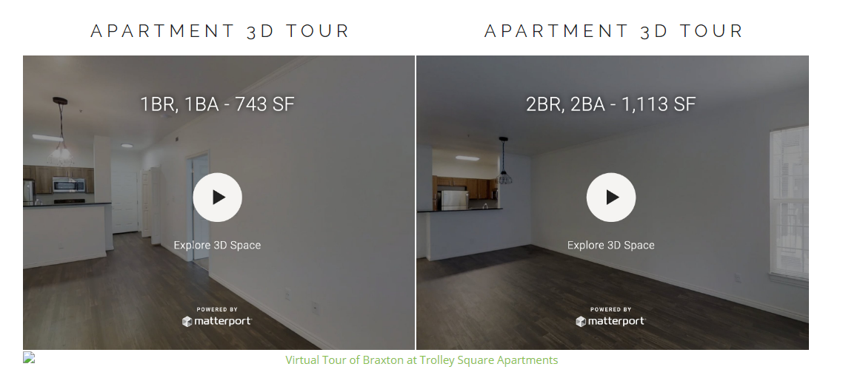
Virtual Tours: A Well Proven Alternative

Slide 19
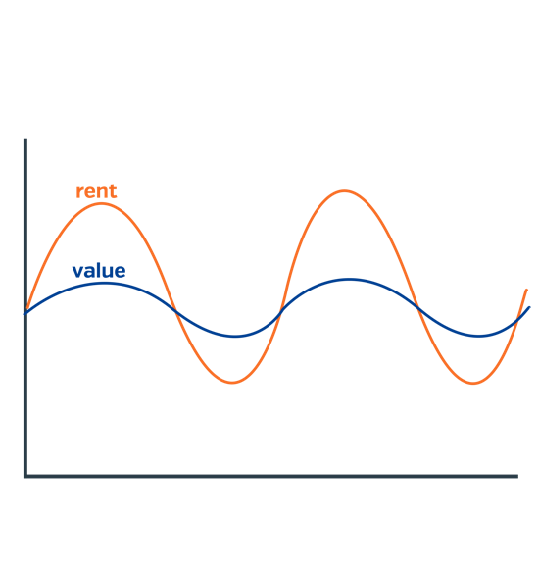
What Happens to Rents and Value?
Expect peaks and troughs in rents but not necessarily apartment values.
Notes:
There’ll be peaks and troughs in rents but not the same in values.
Luxury demand will drop off and there’ll be stress in B and C quality buildings – B-quality buildings are likely best positioned.

Slide 20
Stay on Point
Talking to Your partners, investors and lenders
Top of Waves
Short Term Actionable Advice
Medium Term
Long Term
Notes:
Communication and relationships are more important now than they were before. Relationships are always important, but more important now than ever.

Slide 21
SHOWCASE OPINION: Will Repricing Occur on Current Deals?
Top of Waves
Short Term Actionable Advice
Medium Term
Long Term
Yes, many buyers will try, but it won’t be much
Many will ask but most will be rejected.
Notes:
There’s anecdotal evidence that 50% of recent deals tried to be repriced, but only managed less than 5%.
Message: There’s not a lot of product in the marketplace – few sellers are distressed.
We have 1 deal where the APS was signed Thursday last week, they kept the price the same but asked more time for due diligence which is reasonable, and also inserted a financing clause that wasn’t there before.
These are rational asks.

Slide 22
We’re looking for a trusted voice to provide guidance
You’re a leader in your organization, you must show strength and vision.
Top of Waves
Short Term Actionable Advice
Medium Term
Long Term
Notes:
What we’re doing: If our work runs out, we’ll build a stronger company with stronger standard operating practices.
I have made it a point to call all my clients and have meaningful discussions with them and give them advice that I know is correct.

Slide 23
Your $10M building is probably still worth $10M.
Notes:
Suggest that they sell their $10M in apartment building to buy $10M in RBC stock, which may go up to $15M again.

Slide 24
The Medium Term: Transactions & Value
Real estate is a 6-month lag business – from sale to close
Transactions will slow down, and there will be no cap rates – there’ll be a lag time created here – everything will be a guess.
Existing deals are going through
Repricing is occurring on some deals but minimal
Money will remain cheap in the short term to boost sales
Top of Waves
Short Term Actionable Advice
Medium Term
Long Term
Notes:
Sale that occurs tomorrow, happened 6 months ago in another world.
Some landlords may think that because interest rates have gone down, cap rates will go down. Cap rates are an indication of the future. And if the future is not clear, cap rates go up but the interest rate reduction may offset that and things will be the same.

Slide 25
Investors
Some investors will be sitting on cash, desperately and immediately wanting to buy real estate.
Some will be paralyzed.
REITs vs. Private Investors
Top of Waves
Short Term Actionable Advice
Medium Term
Long Term

Slide 26
Financing
Re-financing existing buildings or take out financing on new construction could be extraordinary (but slower)
It’s hard to know what the capital markets will do.
There’ll be a larger delta between cap rates and mortgage rates.
Top of Waves
Short Term Actionable Advice
Medium Term
Long Term
Notes:
5 years 1.6% 10 years around 2%.
Refinancing on an existing building or take out financing on a recently leased up building could be a wonderful opportunity.

Slide 27
SHOWCASE IDEA
You could hedge your financing during the due diligence stage.
Notes:
To take advantage of extraordinarily low interest rates, we’ll talk to our lenders next week about SHOULD people be hedging to lock in the lower interest rate now.

Slide 28
Cap Rates
Cap Rates are like the stock market, they predict the future.
Notes:
The future is no longer as clear, so that might affect cap rates.
BUT, the revenue stream is not as clear as it used to be. Offsetting this is the decrease in interest rates – the spread is going to be extraordinary.

Slide 29
It’s Business as Usual
People are looking for strong leaders right now, and guidance.
There’s likely a disconnect between front line and head office, and the bigger your company the bigger that disconnect could be.
Notes:
They’re not looking for bravado. They’re looking for practical advice and nobody knows for sure, but you can rely on your amortized knowledge and experience to make reasonable guesses.
There’s a disconnect between your front line staff and the head office. And the bigger your company is the bigger that disconnect is.

Slide 30
What’s the Wrong thing to do?
A blanket rent reduction
Not auditing your leasing process
Falling behind in your leasing – it’s difficult to catch up
Notes:
Talk about two families on a road trip;.

Slide 31
What Should Lenders Do?
1. Talk to your clients
2. Look at predictability of their rent based on resident profile
Notes:
A few lenders have contacted us wanting our opinions on how strong a particular building is in terms of its resident profile.

Slide 32
Join Us For Next Week’s Lenders Seminar
Visit crowdcast.io/e/lenders to register.

